Slide 1
PFM Reforms in Bangladesh through iBAS++
Budget at a Glance
DDO Management through iBAS++
Reforms in Bangladesh
Budget Execution
Pay and Accounting
TA/DA Bill
Leave Account Automation
Social Safety Net Program
Pension Simplification
PL Account Management
DDO Other Bills Automation
A-Challan
Foreign Mission Accounting
GPF Management
মোঃ রাশেদুল ইসলাম
কনসালটেন্ট
আইবাস++ স্কিম, অর্থ বিভাগ
BACS and iBAS++ স্কিম, অর্থ বিভাগ

Slide 2
Budget: 2023-2024
Revenue and Foreign Grants | Expenditure | Financing
= Revenue + Grants = (Tax + Non-Tax) + Grants = (NBR+Non-NBR) + Non-Tax + Grants = 4,30,000+20,000+50,000+3,900 = 5,03,900 | = Operating + Development + Others = (Recurrent+Capital)+Development+Others = 4,36,247+39,034+2,77,582+8,922 = 7,61,785 | = Foreign Loan + Domestic Loan = FL+ (BS+Non-BS) = FL + (LTD+STD) + (NSC+Others) = 1,02,490+86,580+45,815+18,000+5,000 = 2,57,885
Key Words: Grants, Non-NBR Tax, Non-Tax Revenue, Capital Expenditure, LTD, STD
Demands for Grants
Budget
Public Account of the Republic
Financial Year
Finance Act
AFS
Consolidated Fund
Appropriation Act
BACS and iBAS++ স্কিম, অর্থ বিভাগ

Slide 3
Revenue Details: 2023-2024
Indirect Tax
Value Added Tax
Supplementary Duty
Import Duty
Excise Duty
Direct Tax
Income Tax
Travel Tax
4,30,000
NBR Tax
(85.33%)
5,03,900
Revenue and Foreign Grants
50,000
Non-Tax Revenue
(9.92%)
20,000
Non-NBR Tax
(3.97%)
Administrative Fees
Rent
Dividends
Others
3,900
Foreign Grants
(0.77%)
Stamp Duty
Narcotics & Liquor
Taxes on uses of Goods
BACS and iBAS++ স্কিম, অর্থ বিভাগ

Slide 4
Beneficiaries of iBAS++
12,71,317
GoB Employees
8,63,167
Pensioners
1,01,21,989
Social Safetynet
1,78,321
Vendors
1,62,55,329
Students
34,97,353
Corona Victims
Recipients of EFTs
Integrated Budget and Accounting System
About iBAS++
IFMIS
Real time transaction
Comprehensive financial reporting
Quick delivery of service
Interfaced with NID, TIN, e-GP, ADP MS, NSD
BACS and iBAS++ স্কিম, অর্থ বিভাগ

Slide 5
GoB Employee Database
Online Pay Fixation
Service Stage Management
Online pay and allowances
GPF, Loan and Advance, Income Tax Statement, House Building Loan
Govt. Accommodation
Pension Automation
Centralized Pension Database based on NIDs
Unique e-PPO
Payment through EFTs
Mobile App for life verification
National Saving Scheme
Automated Transaction of Saving Certificates
EFT payment for Profit and Principal to client's Bank A/C
A-Challan
Web-based System
Instant system generated challan
Around 84 types of revenues/fees can be deposited through ACS
Payment Method: Internet Banking, MFS, Debit Card, Credit Card.
BACS and iBAS++ স্কিম, অর্থ বিভাগ

Slide 6
Automated Fund Management System
Online GPF A/C Opening
GPF Nominee Entry and Change
Yearly Subscription Change
System Generated Ledger
System Generated A/C Slip
Produce aggregate closing balance of all employees
Govt. liabilities against GPF can be calculated easily at any time
Budget allocation for GPF profit becomes more rational
Control Ledger allows decision makers to have a better cost-benefit analysis
BACS and iBAS++ স্কিম, অর্থ বিভাগ

Slide 7
Payment Systems
Bangladesh Bank operates four major inter-bank payment systems:
BACPS: Bangladesh Automated Cheque Processing System
BEFTN: Bangladesh Electronic Funds Transfer Network
NPSB: National Payment Switch Bangladesh
RTGS: Real Time Gross Settlement System
BACS and iBAS++ স্কিম, অর্থ বিভাগ

Slide 8
Payment Systems
Cheque Imaging and Truncation (CIT) technology for electronic presentment and payment of paper-based instruments.
BACPS operates in a batch processing mode.
High Value (HV) Cheque Clearing (Cheque amounting Tk. 5,00,000 or above) and Regular Value (RV) Cheque clearing.
At present HV presentment cut off time is at 12:00 and the return cut off is at 15:00
RV clearing presentment cut off time is at 12:30 and return cut off is at 17:00
It reduces time and cost of domestic clearing.
It minimizes paper handling and manual intervention.
BACS and iBAS++ স্কিম, অর্থ বিভাগ

Slide 9
Drawing and Disbursing Officer
DDO is a very important person in public sector financial administration.
He has been entrusted to draw bills to pay for services rendered or supplies made to government.
Every govt. office should have a DDO to draw money from the govt. exchequer and to disburse such money among the recipients.
All heads of the offices are DDO [SR-65] Delegation of power by office head to the subordinate officer. [SR-66]
BACS and iBAS++ স্কিম, অর্থ বিভাগ

Slide 10
Drawing and Disbursing Officer
Money cannot be withdrawn from public fund without presentation of bills at the treasury (Accounts Office) signed by DDO. [SR-83]
Gazetted govt. employees will sign the bills as SDO and submit directly at accounts office except TA bills. TA bills require counter sign of the controlling officer. [SR-85]
A bill becomes vouchers when it is duly receipt and paid.
BACS and iBAS++ স্কিম, অর্থ বিভাগ

Slide 11
Drawing and Disbursing Officer
The cash book should be closed and balanced on each day and the head of the office will check the cash book.
At the end of the month, the office head should verify the cash balance and certify its correctness with dated signature.
Pen through the incorrect entry end insert the correct one in red ink between the line.
Officer should initial with date every such correction.
BACS and iBAS++ স্কিম, অর্থ বিভাগ

Slide 12
Drawing and Disbursing Officer
To enable the disbursing officer to watch the progress of the expenditure under each item as compared with the appropriation for it, a progressive total of all the columns of the concerned register must be made monthly immediately after the monthly total. [SR-178]
Every govt. officer who is authorized to draw cheques or sign or countersign bills shall send a specimen signature to the concerned Accounts Office and the Bank. [SR-91]
BACS and iBAS++ স্কিম, অর্থ বিভাগ

Slide 13
Drawing and Disbursing Officer
Every public officer is expected to spend public money as a person of ordinary prudence would have spent his or her own money.
The expenditure should not be more than the occasion demands.
No authority should exercise its powers of sanctioning expenditure to pass an order which will be directly or indirectly go to its own advantages.
BACS and iBAS++ স্কিম, অর্থ বিভাগ

Slide 14
Drawing and Disbursing Officer
Responsible for enforcing financial order and strict economy at every step. [GFR-11]
Controlling officer must see that funds are spent in the public interest and upon objects on which money was provided. [GFR-12]
An officer who signs or countersigns a certificate is personally responsible for the fact certified to… [GFR-16]
BACS and iBAS++ স্কিম, অর্থ বিভাগ

Slide 15
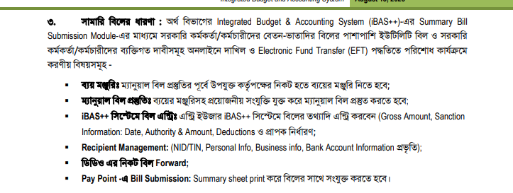

Slide 16
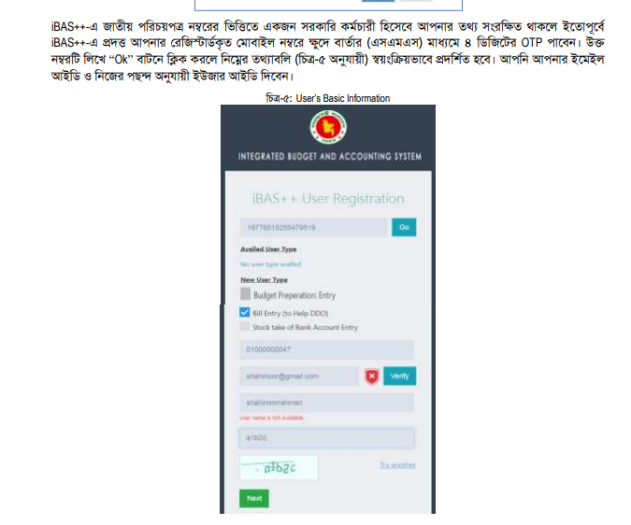
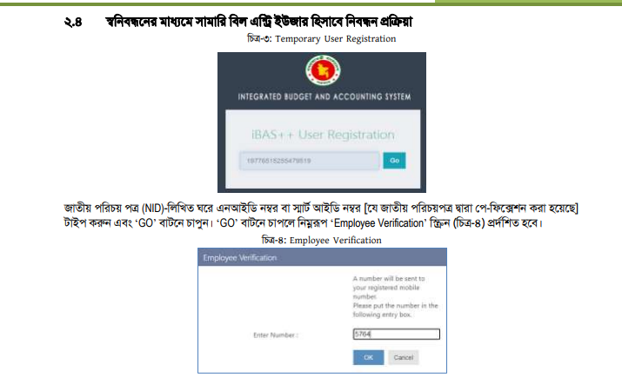
এন্ট্রি ইউজার রেজিস্ট্রেশন ও অ্যাপ্রুভাল

Slide 17
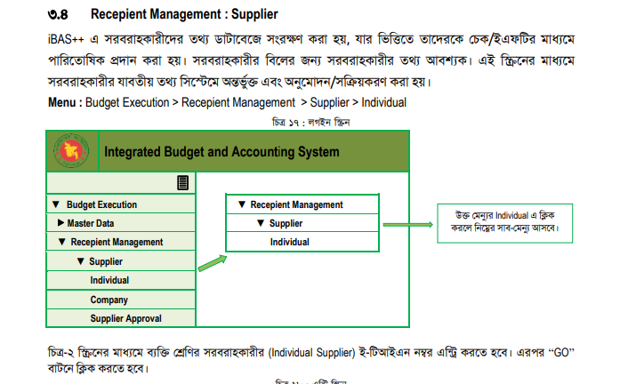

Slide 18
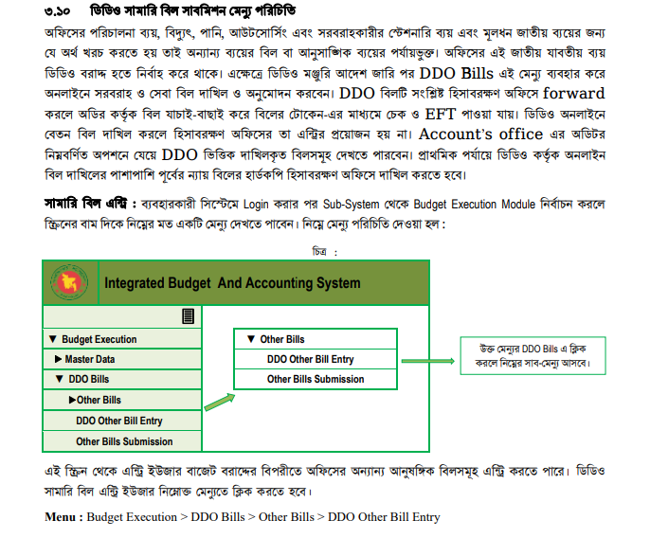
বিল সাবমিশন মেন্যু পরিচিতি

Slide 19
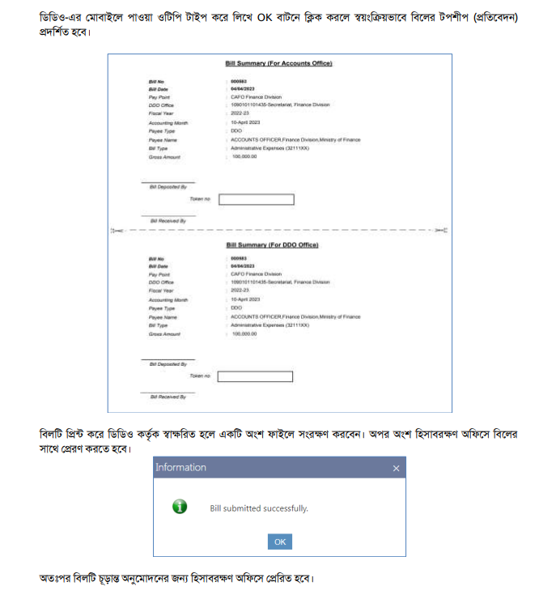
বিল সাবমিশনের পরে প্রাপ্ত সামারী শীট

Slide 22
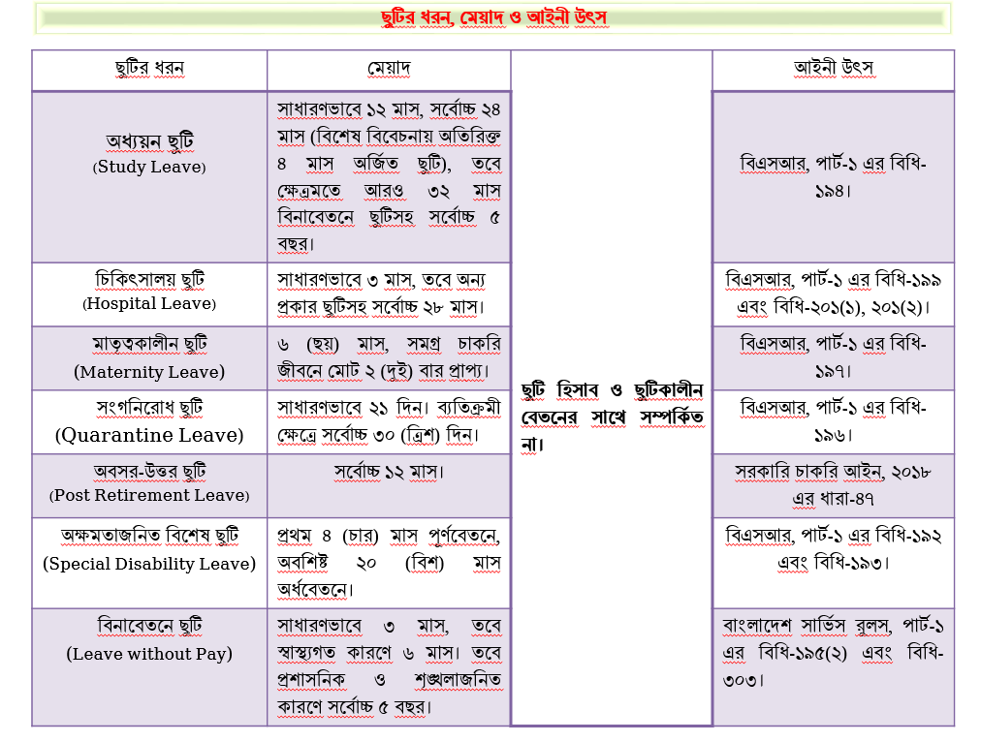

Slide 23
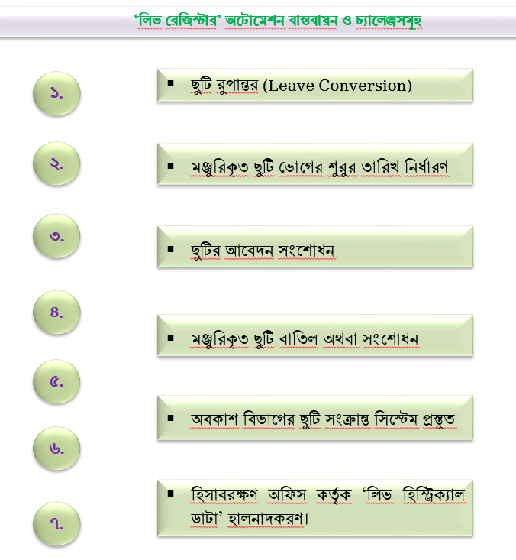

Slide 24
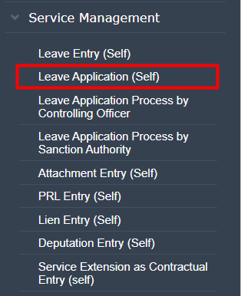
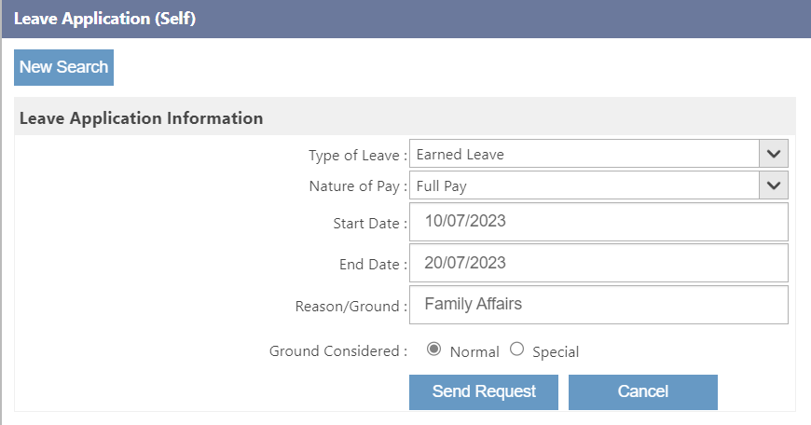
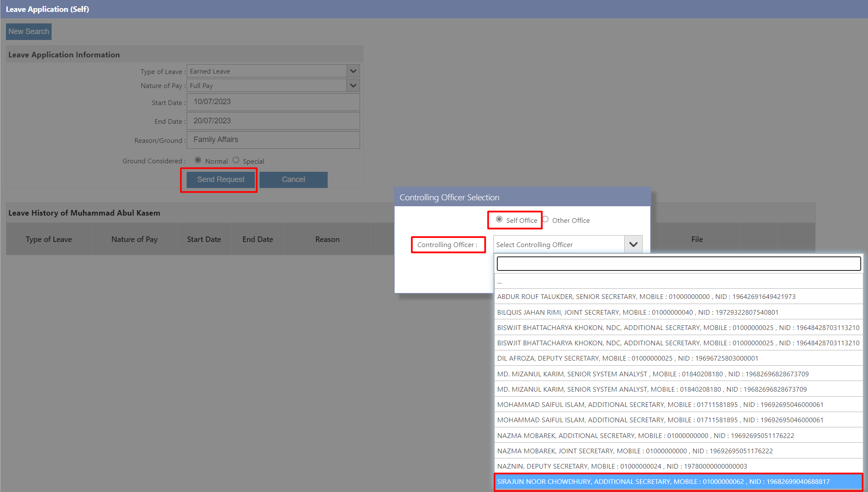
‘লিভ রেজিস্টার’ অটোমেশন ফ্লো (SDO Portion)
সরকারি কর্মচারীদের ‘ছুটি হিসাব’ অটোমেশন, (Leave Account Automation through iBAS++)
Slide-
24

Slide 25
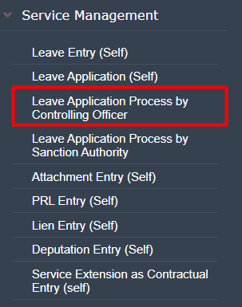
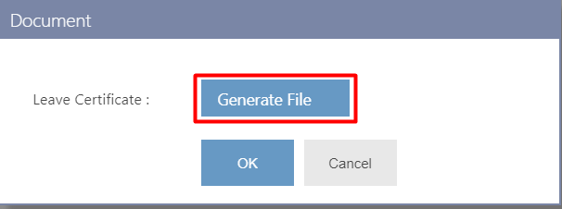
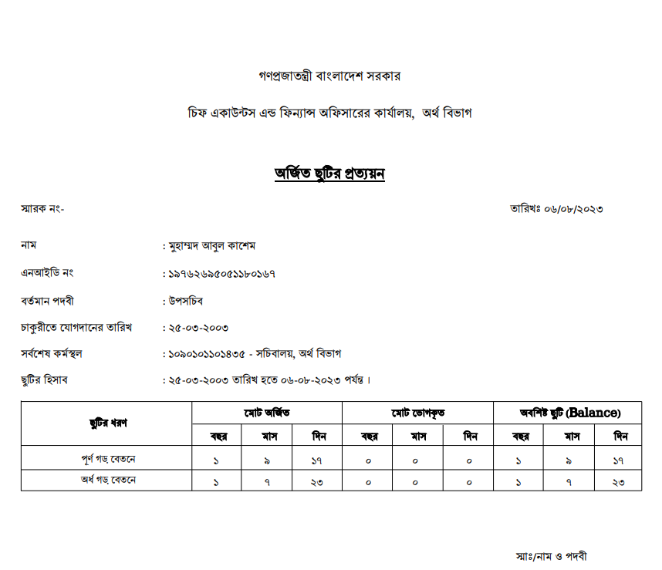
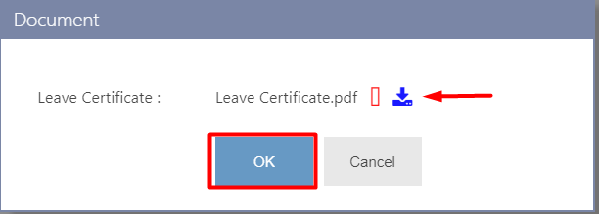
‘লিভ রেজিস্টার’ অটোমেশন ফ্লো (Controlling Officer)
সরকারি কর্মচারীদের ‘ছুটি হিসাব’ অটোমেশন, (Leave Account Automation through iBAS++)
Slide-
25

Slide 26
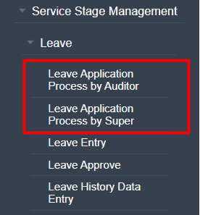
‘লিভ রেজিস্টার’ অটোমেশন ফ্লো (Accounts Office)
সরকারি কর্মচারীদের ‘ছুটি হিসাব’ অটোমেশন, (Leave Account Automation through iBAS++)
Slide-
26

Slide 27
‘লিভ রেজিস্টার’ অটোমেশন বাস্তবায়ন ও চ্যালেঞ্জসমূহ
ছুটি রুপান্তর (Leave Conversion);
মঞ্জুরিকৃত ছুটি ভোগের শুরুর তারিখ নির্ধারণ;
ছুটির আবেদন সংশোধন;
মঞ্জুরিকৃত ছুটি বাতিল অথবা সংশোধন;
অবকাশ বিভাগের ছুটি সংক্রান্ত সিস্টেম প্রস্তুত;
হিসাবরক্ষণ অফিস কর্তৃক ‘লিভ হিস্ট্রিক্যাল ডাটা’ হালনাদকরণ;
হিসাব মহানিয়ন্ত্রক (সিজিএ) এর কার্যালয়ের সাথে এ স্কিম কর্তৃক একটি কর্মশালার আয়োজন করা হবে;
সকল এসডিও, ডিডিও এবং হিসাবরক্ষণ অফিসের সংশ্লিষ্ট জনবলকে প্রশিক্ষণ প্রদান করা হবে;
কয়েকটি সিএএফও অফিসে পাইলটিং শুরু করা হবে;
সিজিএ অফিসের তত্ত্বাবধানে সকল হিসাবরক্ষণ অফিস কর্তৃক গেজেটেড কর্মচারীদের ‘লিভ হিস্ট্রিক্যাল ডাটা’ সিস্টেমে হালনাগাদকরণ করা হবে।
সরকারি কর্মচারীদের ‘ছুটি হিসাব’ অটোমেশন, (Leave Account Automation through iBAS++)
Slide-
27

Slide 28
Thanks for Patience
BACS and iBAS++ স্কিম, অর্থ বিভাগ

